Slide 1

Hadoop ecosystem
Divya Sree Tummala

Slide 2
Topics Covered:
What is Apache Kafka?
Main Components/Daemons
What is Kafka used for?
Kafka in action: A sports app example
Alternative tools of Kafka
Installing Kafka on windows
Conclusion

Slide 3
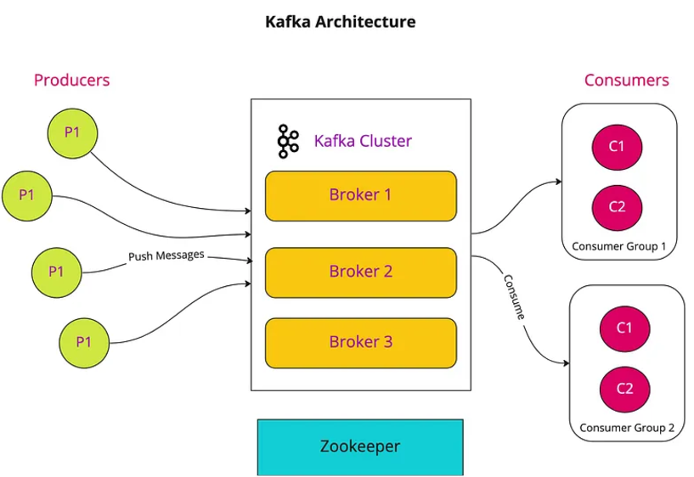
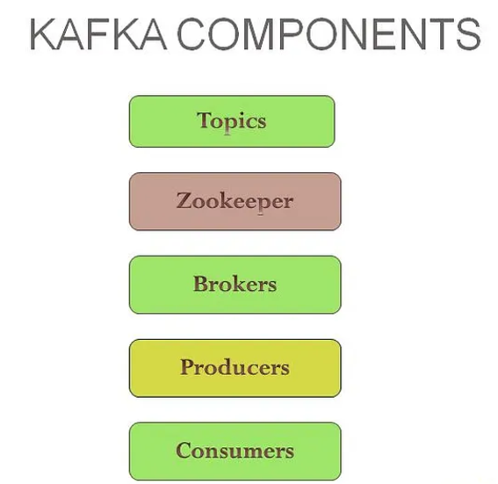
What is Apache Kafka?
Definition: A distributed streaming platform designed for building real-time data pipelines and streaming applications.
Key Features:
High throughput
Scalability
Durability
Fault-tolerance
Main Components/Daemons:
Topics: Categories for storing messages, organized in partitions for scalability.
Zookeeper: Manages Kafka's distributed system, keeping track of brokers and topics. Essential for cluster operation.
Brokers: Manages the storage of messages and handles requests from producers and consumers.
Must be running for Kafka to function.
Producers: Applications that send data (messages) to Kafka topics.
Consumers: Applications that read data from Kafka topics.
Partitions: Subdivisions of a topic, allowing for parallel processing and scalability.
Replicas: Copies of partitions across multiple brokers for fault tolerance.

Slide 4
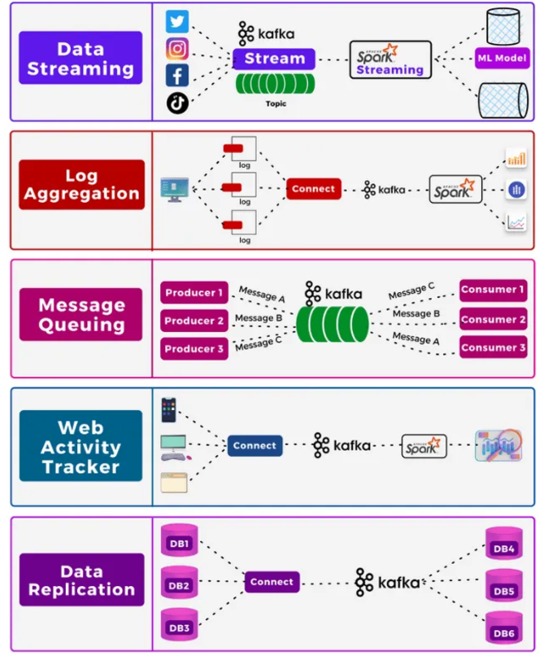
What is Kafka Used For?
Real-time data streaming: Processing data as it arrives (e.g., website activity, sensor data, financial transactions).
Log aggregation: Collecting and analyzing logs from multiple sources.
Message queuing: Reliable, high-throughput message delivery.
Web activity tracker: Tracks and processes user interactions on websites for analytics and personalization.
Data replication: Synchronizes and distributes data across multiple systems for fault tolerance and scalability

Slide 5
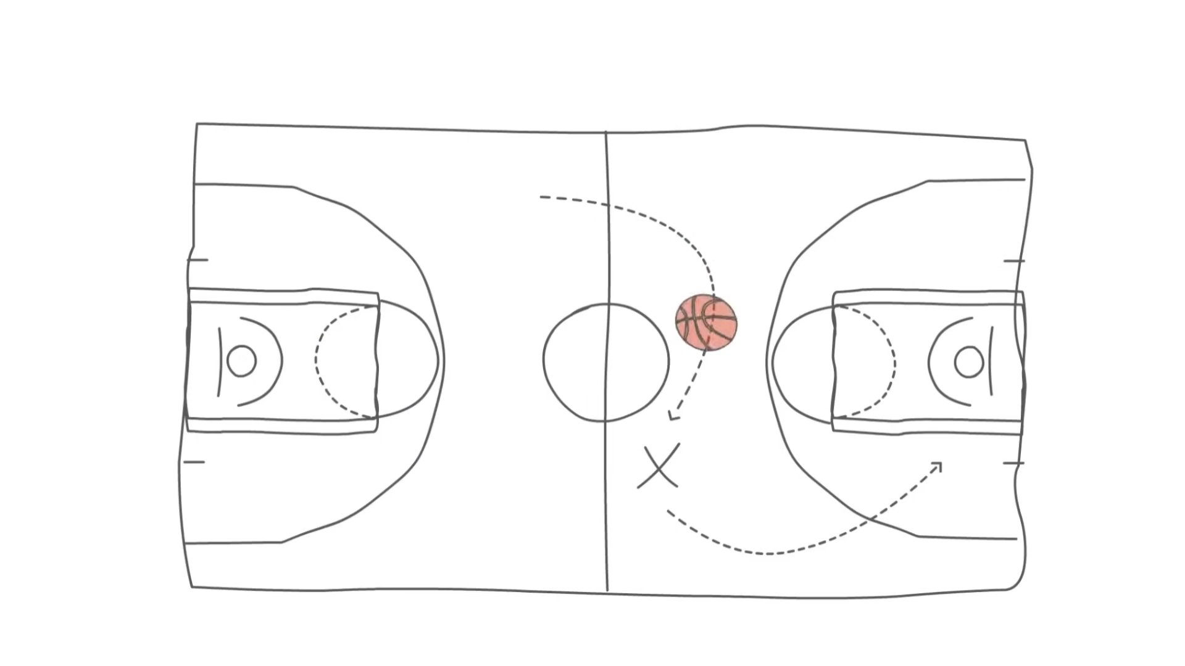
Kafka in Action: A Sports App Example

Slide 6






Alternative Tools to Apache Kafka
Amazon Kinesis: A fully managed real-time data streaming service for high-volume ingestion and processing; excels at real-time analytics and event processing at massive scale.
RabbitMQ: A flexible, open-source message broker ideal for smaller-scale applications requiring various messaging patterns; supports message queuing and routing, but scalability is limited compared to Kafka.
ActiveMQ: A mature, open-source message broker offering diverse messaging features; suitable for enterprise messaging and integration, but high-throughput scalability might be a constraint.
Red Hat AMQ: An enterprise-grade messaging solution built on ActiveMQ, prioritizing robust management, security, and high availability for mission-critical applications; enhances ActiveMQ with enterprise-grade features.
IBM MQ: A highly reliable enterprise messaging system for critical applications demanding strong security and data integrity; excels in scenarios requiring guaranteed message delivery and robust transaction management.
Amazon SQS: A simple, managed queue service for basic asynchronous communication and decoupling; suitable for less demanding applications needing simple message queuing but not high-throughput stream processing.

Slide 7
Installing Kafka on Windows
Prerequisites
Java: Install JDK 8+ and set the JAVA_HOME environment variable.
Zookeeper: Comes bundled with Kafka.
2. Download Kafka
Visit kafka.apache.org/downloads. Download and extract the Kafka binary (e.g., kafka_2.13-3.9.0.tgz)
3. Configure Kafka
Navigate to the config directory in your Kafka folder (C:\kafka\config).
Edit the following files using a text editor (e.g., Notepad++ or VS Code):
zookeeper.properties: This file contains the configurations for ZooKeeper, which Kafka uses for distributed system coordination. Default settings should work, but ensure dataDir points to a writable directory:
dataDir = C:/kafka/zookeeper-data
server.properties: This file configures the Kafka broker. Key configurations to check or update:
log.dirs=C:/kafka/kafka-logs

Slide 8
Set Up Environment Variables
Add Kafka's bin directory to the system Path.
C:\kafka\bin
Start ZooKeeper
Open a Command Prompt or PowerShell window and navigate to the Kafka directory:
cd C:\kafka
Start ZooKeeper:
.\bin\windows\zookeeper-server-start.bat .\config\zookeeper.properties
6. Start Kafka Broker
.\bin\windows\kafka-server-start.bat .\config\server.properties

Slide 9
Create Topic
.\bin\windows\kafka-topics.bat --create --topic test --bootstrap-server localhost:9092
View List
bin\windows\kafka-topics.bat --list --bootstrap-server localhost:9092
9. Start a Producer
.\bin\windows\kafka-console-producer.bat --topic test --bootstrap-server localhost:9092
10. Start a Consumer
.\bin\windows\kafka-console-consumer.bat --topic test --from-beginning --bootstrap-server localhost:9092

Slide 10

Conclusion:
Scalable & Fault-Tolerant Architecture
Real-time Data Streaming Capabilities
Wide Range of Applications
Strong Community & Ecosystem

